Slide 1
Data Mining Topic: Clustering
Dr. J Angel Arul Jothi
Department of Computer Science

Slide 2
Text Book Chapter 8 & 9
Sections

Slide 3
Cluster
Cluster
A collection/group of data objects
Objects within a cluster are similar to one another and they are dissimilar to the objects in other clusters
Clustering is unsupervised learning
no predefined class labels
Typical applications
As a stand-alone tool to get insight into data
As a preprocessing step for other algorithms

Slide 4
What is Cluster Analysis?
Given a set of objects, find groups of objects that are meaningful or useful
Inter-cluster distances (dissimilarity) are maximized
Intra-cluster distances (dissimilarity) are minimized

Slide 5
Applications of Cluster Analysis
Information Retrieval: Group related documents
Biology: Group genes and proteins that have similar functionality
Medicine and Psychology: identify different subcategories of illness
Business:
Group stocks with similar price fluctuations
Group customers
Reduce the size of large data sets

Slide 6
Requirements of Clustering algorithms
Scalability
Ability to deal with different types of attributes
Minimal domain knowledge required to determine input parameters
Ability to deal with noise and outliers
Insensitivity to order of input records
Incorporation of user-specified constraints
Interpretability and usability

Slide 7
Difficulty in clustering
Notion of a cluster can be ambiguous
Definition of a cluster is imprecise
The best definition depends on the nature of data and the desired results

Slide 8
Difficulty in clustering
How many clusters?
Two Clusters
Four Clusters
Six Clusters

Slide 9
Types of Clustering
Partitional Clustering
Hierarchical clustering
Graph-based clustering
Density-based clustering

Slide 10
Partitional Clustering
Divide data objects into k (usually given by user) mutually exclusive groups (clusters)
Each data object is in exactly one group
Uses distance metric
Works well for spherical-shaped clusters in small-to medium-size databases
Example: K-means and its variants

Slide 11
Partitional Clustering
Original Points
A Partitional Clustering

Slide 12
K-means Clustering
Partitional clustering approach
Prototype based clustering
Defines prototype in terms of the centroid
Number of clusters, K, must be specified
Each cluster is represented using a centroid (center point)
Centroid can be
Mean (continuous attributes)
Medoid- most representative point of a cluster (categorical attributes)
Each point is assigned to the cluster with the closest centroid

Slide 13
K-means Clustering
Randomly select k of the objects in dataset (D)
The selected objects represent the k cluster centers
For each of the objects
Compute distance between the object and all cluster center
Assign an object to the cluster to which it is the most similar
For each cluster
Compute the new mean using the objects assigned to the cluster
Repeat steps 3 and 4 until the assignment is stable

Slide 14
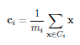
Centroid - Example
Compute the centroid of a cluster containing the three two-dimensional points, (1,1), (2,3), and (6,2)
m_{i} is the number of points in cluster i
((1 + 2 + 6)/3, ((1 + 3 + 2)/3) = (3, 2)

Slide 15
K-means Example 1
Show the working of k-means clustering for the following 1 dimensional objects 1, 2, 5, 6,7 that are to be clustered into k=2 clusters using squared Euclidean distance. Assume initial centers as c1= 5 and c2 = 6

Slide 16
K-means Example 1

Slide 17
K-means Example 1

Slide 18
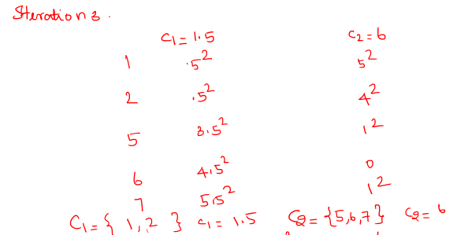
K-means Example 1
SSE = (0.5^2+0.5^2) + (1^2+0+1^2) = 2.5

Slide 19
K-means Example 1
Show the working of k-means clustering for the following 1 dimensional objects 1, 2, 5, 6,7 that are to be clustered into k=2 clusters using squared Euclidean distance.
Iteration 1
Randomly select 5 and 6 as initial center
Compute distance between points and cluster center
Assign the points to the cluster to which it is the closest
Two clusters are formed: C1={1,2,5} and C2={6,7}
Compute the new cluster center (mean)
c1= 1+2+5/3 = 8/3 = 2.6, mean c2= 6+7/2= 6.5

Slide 20
K-means Example 1
Iteration 2
Cluster center (iteration 1) c1 = 2.6, mean c2 = 6.5
Compute distance between points and cluster center
Assign the points to the cluster to which it is the closest
Two clusters are formed: C1={1,2}, C2={5,6,7}
Compute the new cluster center (mean)
c1=1.5, c2=6

Slide 21
K-means Example 1
Iteration 3
Cluster center (iteration 1) c1 = 1.5, mean c2 = 6
Compute distance between points and cluster center
Assign the points to the cluster to which it is the closest
Two clusters are formed: C1={1,2}, C2={5,6,7}
Compute the new cluster center (mean)
c1=1.5, c2=6
No change in the centroids. Therefore we stop.
SSE = (0.5^2) + (0.5^2) + (1^2) + (1^2) = 2.5

Slide 22
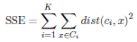
K-means Clustering
An objective function is used to assess the partitioning quality of the clustering technique
The quality of clustering is measured by the within-cluster sum of squares or squared error (E) or scatter
dist is the standard Euclidean (L2) distance between two objects

Slide 23
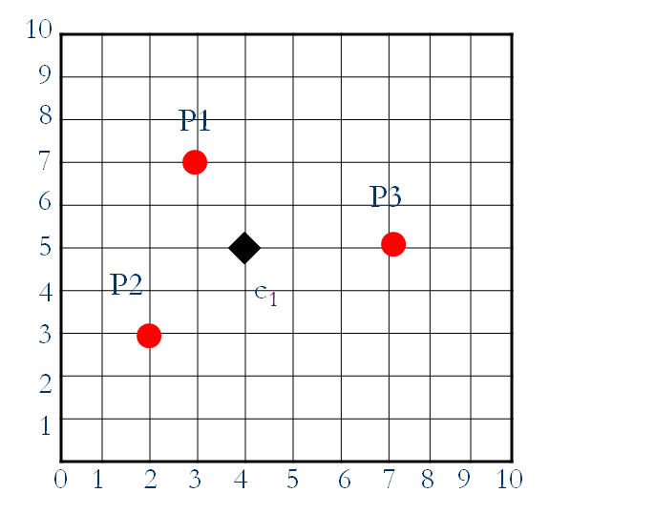
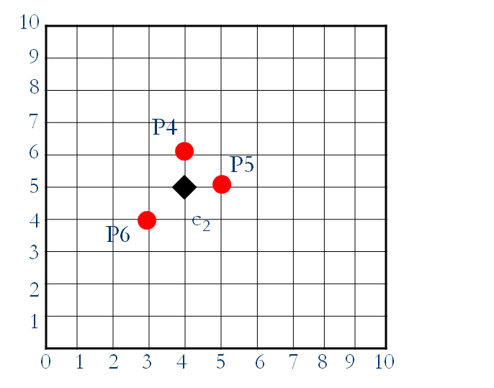
Squared Error of Cluster Example
Compute the sum of squared error (SSE) for the given clusters C1 and C2. Euclidean distance.
Cluster C₁
Cluster C₂

Slide 24
Squared Error of Cluster Example
Cluster C₁
C₁={P1, P2, P3}
P1 = (3, 7)
P2 = (2, 3)
P3 = (7, 5)
c₁ = (4, 5)
|d(P1, c₁)|²
=(sqrt(3-4)²+(7-5)²)² = 5
|d(P2, c₁)|²= 8
|d(P3, c₁)|²=9
Error (C₁)=5 + 8 +9 =22

Slide 25
Squared Error of Cluster Example
Cluster C₂
C₂={P4, P5, P6}
P4 = (4, 6)
P5 = (5, 5)
P6 = (3, 4)
c₂ = (4, 5)
|d(P4, c₂)|²
=(sqrt(4-4)²+(6-5)²)=1
|d(P5, c₂)|²=1
|d(P6, c₂)|²=2
Error (C₂)=1+1+2=4
Total error = 4 +22 = 26

Slide 26
K-means Example 2
Use the k-means algorithm and Euclidean distance to cluster the following 8 examples into 3 clusters:
A1 = (2, 10), A2 = (2, 5), A3 = (8, 4), A4 = (5, 8), A5 = (7, 5), A6 = (6, 4), A7 = (1, 2), A8 = (4, 9)
Suppose that the initial seeds (centers of each cluster) are A1, A4, and A7. Apply the k-means algorithm for 2 epoch only. At the end of each epoch show:
The new clusters (i.e. the examples belonging to each cluster)
The centers of the new clusters
Draw a 10 by 10 space with all the 8 points and show the clusters after the first epoch and the new centroids

Slide 27
K-means Example 2 iteration 1

Slide 28
K-means Example 2

Slide 29
K-means Example 2 iteration 2

Slide 30
K-means Example 2

Slide 31
K-means Example 2

Slide 32
K-means Clustering – Details
Initial centroids are often chosen randomly
Clusters produced vary from one run to another
The centroid is (typically) the mean of the points in the cluster
‘Closeness’ is measured by Euclidean distance, cosine similarity, Manhattan, Jaccard, etc.
Most of the convergence happens in the first few iterations
Time complexity is O( n * K * I * d )
n = number of points, K = number of clusters, I = number of iterations, d = number of attributes

Slide 33
Limitations of K-means
The k-means method can be applied only when the mean of a set of objects is defined
K-means has problems when clusters are of differing
Sizes
Densities
Non-globular shapes
K-means has problems when the data contains outliers
K value to be specified in advance

Slide 34
Hierarchical clustering
Decomposes the objects in an hierarchical fashion
Based on how the hierarchical decomposition is formed it can be of two types
Agglomerative
Divisive
Hierarchical methods suffer from the fact that once a step is done it can never be undone
Hierarchical algorithms use a similarity or distance matrix
Merge or split one cluster at a time

Slide 35
Agglomerative Hierarchical Clustering
Bottom-up approach
Starts with each object forming a separate group/cluster
In successive iteration merge the objects or groups that are close to one another
This process is repeated until all the groups are merged into one or a termination condition holds

Slide 36
Hierarchical Clustering
Produces a set of nested clusters organized as a hierarchical tree
Can be visualized as a dendrogram
A tree like diagram that records the sequences of merges or splits

Slide 37
Strengths of Hierarchical Clustering
Do not have to assume any particular number of clusters
Any desired number of clusters can be obtained by ‘cutting’ the dendrogram at the proper level
Then each connected component forms a cluster

Slide 38
Agglomerative Hierarchical Clustering Algorithm
Most popular hierarchical clustering technique
Compute the proximity matrix
Let each data point be a cluster
Repeat
Merge the two closest clusters
Update the proximity matrix
Until only a single cluster remains
Key operation is the computation of the proximity of two clusters
Different approaches to define the distance between clusters distinguish the different algorithms

Slide 39
How to Define Inter-Cluster Distance
Similarity?
MIN
MAX
Group Average
Distance Between Centroids
Methods driven by an objective function
Ward’s Method uses squared error

Slide 40
How to Define Inter-Cluster Similarity
p5
p2
p1
p3
p8
C2
p6
C1
p4
p7
MIN
Proximity of two clusters is based on the two closest points in the different clusters
Also called as single link or linkage
d(C1, C2) = min{ d(p1, p5), … d(p1, p8), d(p2, p5), …. d(p2, p8), d(p3, p5), ….. d(p3, p8), d(p4 p5), …. d(p4, p8)}

Slide 41
How to Define Inter-Cluster Similarity
p5
p2
p1
p3
p8
C2
p6
C1
p4
p7
MAX
Proximity of two clusters is based on the two most distant points in the different clusters
Also called as complete linkage
d(C1, C2) = max{ d(p1, p5), … d(p1, p8), d(p2, p5), …. d(p2, p8), d(p3, p5), ….. d(p3, p8), d(p4 p5), …. d(p4, p8)}

Slide 42
How to Define Inter-Cluster Similarity
p5
p2
p1
p3
p8
C2
p6
C1
p4
p7
Group Average
Proximity of two clusters is the average of pairwise proximity between points in the two clusters

Slide 43
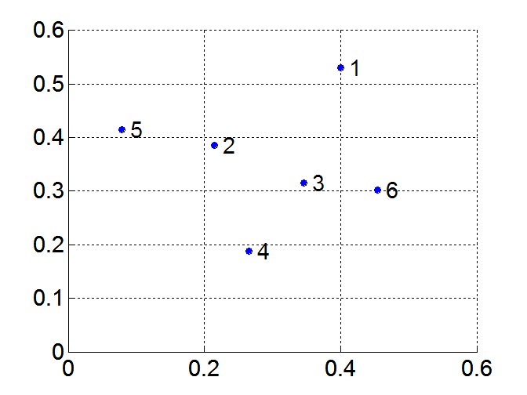
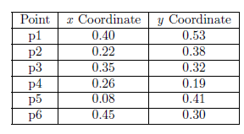
Example
Consider the 6, two-dimensional data points shown in figure along with the x and y coordinates of the points and the Euclidean distances between them. Illustrate hierarchical agglomerative clustering algorithm to cluster these points using min, max and average as the distance metric. Show the clusters formed using a cluster diagram and a dendogram
Data points

Slide 44
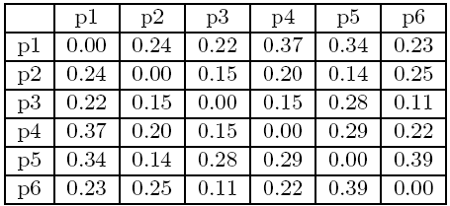
Example
Distance Matrix

Slide 45
MIN or Single link
Step 1
Combine p3 and p6 into a single cluster
Recompute the proximity matrix
 | p1 | p2 | P3,p6 | p4 | p5
p1 | 0
p2 | 0.24 | 0
p3,p6 | 0.22 | 0.15 | 0
P4 | 0.37 | 0.20 | 0.15 | 0
p5 | 0.34 | 0.14 | 0.28 | 0.29 | 0

Slide 46
MIN or Single link
Step 2
Combine p2 and p5 into a single cluster
Recompute the proximity matrix
 | p1 | p2,p5 | p3,p6 | p4
p1 | 0
p2,p5 | 0.24 | 0
p3,p6 | 0.22 | 0.15 | 0
p4 | 0.37 | 0.20 | 0.15 | 0

Slide 47
MIN or Single link
Step 3
Combine {p2,p5} and {p3,p6} into a single cluster
Recompute the proximity matrix
 | p1 | {p2,p5}{p3,p6} | p4
p1 | 0
{p2,p5} {p3,p6} | 0.22 | 0
P4 | 0.37 | 0.15 | 0

Slide 48
MIN or Single link
Step 4
Combine p4 with {{p2,p5} {p3,p6}} into a single cluster
Recompute the proximity matrix
 | p1 | {p2,p5}{p3,p6},p4
p1 | 0
{p2,p5} {p3,p6} , p4 | 0.22 | 0

Slide 49
MIN or Single link
Step 5
Combine p1 with {{p2,p5} {p3,p6}, p4} into a single cluster

Slide 50
MIN or Single link
5
1
3
5
2
1
2
3
6
4
4
Dendrogram
Nested Clusters

Slide 51
Strengths of MIN
Original Points
Six Clusters
Can handle non-elliptical shapes
Sensitive to noise and outliers

Slide 52
MAX or Complete Linkage
Distance Matrix

Slide 53
MAX or Complete Linkage
Step 1
Combine p3 and p6 into a single cluster
Recompute proximity matrix
 | p1 | p2 | p4 | p5 | p3,p6
p1 | 0
p2 | 0.24 | 0
p4 | 0.37 | 0.20 | 0
p5 | 0.34 | 0.14 | 0.29 | 0
p3, p6 | 0.23 | 0.25 | 0.22 | 0.39 | 0

Slide 54
MAX or Complete Linkage
Step 2
Combine p2 and P5
Recompute proximity matrix
 | p1 | p4 | p2,p5 | p3,p6
p1 | 0
p4 | 0.37 | 0
p2,p5 | 0.34 | 0.29 | 0
p3,p6 | 0.23 | 0.22 | 0.39 | 0

Slide 55
MAX or Complete Linkage
Step 3
Combine p4 and {p3,p6}
Recompute proximity matrix
 | p1 | {p2,p5} | {p3, p4,p5}
p1 | 0
{p2,p5} | 0.34 | 0
{p3,p4, p6} | 0.37 | 0.39 | 0

Slide 56
MAX or Complete Linkage
Step 4
Combine p1 and {p2,p5}
Recompute proximity matrix
 | {p1, p2, p5} | {p3,p6, p4}
{p1, p2, p5} | 0
{p3,p4, p6} | 0.39 | 0

Slide 57
MAX or Complete Linkage
Step 5
Combine {p1, p2,p5} and {p3,p6, p4}

Slide 58
MAX or Complete Linkage
4
1
2
5
5
2
3
6
3
1
4
Nested Clusters
Dendrogram

Slide 59
Strength & Limitations of MAX
Tends to break large clusters
Biased towards globular clusters
Less susceptible to noise and outliers

Slide 60
Group Average
Distance Matrix

Slide 61
Group Average
Step 1
Combine p3 and p6 into a single cluster
Recompute proximity matrix
 | p1 | p2 | p4 | p5 | p3,p6
p1 | 0
p2 | 0.24 | 0
p4 | 0.37 | 0.20 | 0
p5 | 0.34 | 0.14 | 0.29 | 0
p3, p6 | 0.225 | 0.20 | 0.185 | 0.335 | 0

Slide 62
Group Average
Step 2
Combine p2 and p5 into a single cluster
Recompute proximity matrix
 | p1 | p4 | p2,p5 | p3,p6
p1 | 0
p4 | 0.37 | 0
p2,p5 | 0.29 | 0.245 | 0
p3,p6 | 0.225 | 0.185 | 0.2675 | 0

Slide 63
Group Average
Step 3
Combine p4 and {p3,p6} into a single cluster
Recompute proximity matrix
 | p1 | {p2,p5} | {p3,p4,p5}
P1 | 0
{p2,p5} | 0.26 | 0
{p3,p4, p6} | 0.273 | 0.26 | 0

Slide 64
Group Average
Step 4
Combine {p3,p6, p4} with {p2,p5} into a single cluster
Recompute proximity matrix
 | p1 | {p3,p6, p4,p2, p5}
{p1} | 0
{p3,p4, p6, p2, p5} | 0.28 | 0

Slide 65
Group Average
Step 5
Combine {p1} and {p3,p6, p4, p2,p5}

Slide 66
Group Average
Compromise between Single and Complete Link
Strengths
Less susceptible to noise and outliers
Limitations
Biased towards globular clusters

Slide 67
Divisive Hierarchical Clustering
Top-down approach
Starts with all the objects in the same cluster
In successive iteration a cluster is split into smaller clusters
This process is repeated until each object is in one cluster, or a termination condition holds

Slide 68
Divisive Hierarchical Clustering
All the objects are used to form one initial cluster
The cluster is split according to some principle
maximum distance between the closest neighboring objects in the cluster
The cluster-splitting process repeats until, eventually, each new cluster contains only a single object

Slide 69
Divisive Hierarchical Clustering
A challenge with divisive methods is how to partition a large cluster into several smaller ones
For example, there are 2^{n} possible ways to partition a set of n objects into two exclusive subsets, where n is the number of objects
When n is large, it is computationally prohibitive to examine all possibilities
a divisive method uses heuristics in partitioning, which can lead to inaccurate results

Slide 70
Graph-Based Clustering: General Concepts
Graph-Based clustering uses the graph
Consider each data point as a node in a graph
Edge between each pair of data objects
each node is connected to all others
Each edge has a weight which is the proximity (dissimilarity/ similarity) between the two data points it connects
The graph of m points can be represented as a m by m matrix called proximity (weight) matrix
In the simplest case, clusters are connected components in the graph

Slide 72
Sparsification
A complete graph is a graph in which each pair of graph vertices is connected by an edge
Converts dense proximity graph to a sparse proximity graph
Keep the connections to the most similar (nearest) neighbors of a point
Break the connections to less similar (highly dissimilar) points by setting the distance values to 0
Let t be a threshold value, P be the proximity matrix then
P(i,,j) <= t ➔retain the entry
P(i, j) > t ➔0

Slide 74
Sparsification: Advantages
The amount of data that needs to be processed is drastically reduced
Sparsification can eliminate more than 99% of the entries in a proximity matrix
The amount of time required to cluster the data is drastically reduced
The size of the problems that can be handled is increased

Slide 75
Sparsification: Advantages
Clustering may work better
The nearest neighbors of a point tend to belong to the same class/cluster as the point itself
This reduces the impact of noise and outliers and sharpens the distinction between clusters
Graph partitioning algorithms can be used for clustering
Chameleon Clustering method

Slide 76
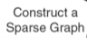
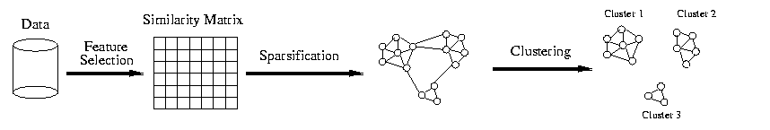
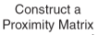
Sparsification in the graph-based clustering process

Slide 77
Graph clustering using a similarity matrix
Step1: Obtain the similarity matrix
Step2: Find the clusters from the similarity matrix
Step1:
Compute the distance between the data points and represent it using a proximity matrix
Convert the proximity matrix to a sparse matrix using a threshold value
Convert the sparse proximity matrix to a similarity matrix
Non zero entries including the diagonal are made as 1
Zero entries are retained as such

Slide 78
Graph Clustering using a similarity matrix
Step 2: Finding cluster from the similarity matrix
Consider a datapoint (row) in the similarity matrix which has got maximum number of ones
Form a cluster with this data point
Include all the neighbors (data points in the row whose entries are 1) of this data point to the cluster
Now for each added data point in the cluster go to the row corresponding to that data point and include the neighbors of the data point to the cluster
Repeat this process until no further data points can be added to the cluster
Remove the rows and columns corresponding to the data points added to the cluster
If there are data points left in the similarity matrix
Repeat the process of finding the clusters again otherwise output the clusters

Slide 79
Graph Clustering using a similarity matrix
Example: Consider the data points A(1,1), B(1,2), C(3,2), D(3,3), E(6,6), F(6,7), G(7,6), H(7,7), I(7,1), J(8,2), K(9,1). Illustrate the working of graph clustering using similarity matrix approach to cluster the given points. Use Euclidean distance metric to form the proximity matrix and a distance threshold value of 2 to construct the sparse matrix.

Slide 80
Graph Clustering using a similarity matrix
Step 1: Construct proximity matrix. Use Euclidean distance measure to compute the distance between data points.
 | A | B | C | D | E | F | G | H | I | J | K
A | 0 | 1 | 2.23 | 2.82 | 7.07 | 7.81 | 7.81 | 8.48 | 6 | 7.07 | 8
B | 1 | 0 | 2 | 2.3 | 6.4 | 7.07 | 7.07 | 7.81 | 6.08 | 7 | 8.06
C | 2.23 | 2 | 0 | 1 | 5 | 5.83 | 5.65 | 6.4 | 4.1 | 5 | 6.08
D | 2.82 | 2.3 | 1 | 0 | 4.24 | 5 | 5 | 5.6 | 4.47 | 5.09 | 6.32
E | 7.07 | 6.4 | 5 | 4.24 | 0 | 1 | 1 | 1.41 | 5.09 | 4.47 | 5.83
F | 7.81 | 7.07 | 5.83 | 5 | 1 | 0 | 1.41 | 1 | 6.08 | 5.38 | 6.7
G | 7.81 | 7.07 | 5.65 | 5 | 1 | 1.41 | 0 | 1 | 5 | 4.12 | 5.38
H | 8.48 | 7.81 | 6.4 | 5.6 | 1.41 | 1 | 1 | 0 | 6 | 5.09 | 6.32
I | 6 | 6.08 | 4.1 | 4.47 | 5.09 | 6.08 | 5 | 6 | 0 | 1.41 | 2
J | 7.07 | 7 | 5 | 5.09 | 4.47 | 5.38 | 4.12 | 5.09 | 1.41 | 0 | 1.41
K | 8 | 8.06 | 6.08 | 6.32 | 5.83 | 6.7 | 5.38 | 6.32 | 2 | 1.41 | 0

Slide 81
Graph Clustering using a similarity matrix
Step 1: Construct similarity matrix. Entries greater than threshold (2) becomes 0, others become 1
 | A | B | C | D | E | F | G | H | I | J | K
A | 1 | 1 | 0 | 0 | 0 | 0 | 0 | 0 | 0 | 0 | 0
B | 1 | 1 | 1 | 0 | 0 | 0 | 0 | 0 | 0 | 0 | 0
C | 0 | 1 | 1 | 1 | 0 | 0 | 0 | 0 | 0 | 0 | 0
D | 0 | 0 | 1 | 1 | 0 | 0 | 0 | 0 | 0 | 0 | 0
E | 0 | 0 | 0 | 0 | 1 | 1 | 1 | 1 | 0 | 0 | 0
F | 0 | 0 | 0 | 0 | 1 | 1 | 1 | 1 | 0 | 0 | 0
G | 0 | 0 | 0 | 0 | 1 | 1 | 1 | 1 | 0 | 0 | 0
H | 0 | 0 | 0 | 0 | 1 | 1 | 1 | 1 | 0 | 0 | 0
I | 0 | 0 | 0 | 0 | 0 | 0 | 0 | 0 | 1 | 1 | 1
J | 0 | 0 | 0 | 0 | 0 | 0 | 0 | 0 | 1 | 1 | 1
K | 0 | 0 | 0 | 0 | 0 | 0 | 0 | 0 | 1 | 1 | 1

Slide 82
Graph Clustering using a similarity matrix
 | A | B | C | D | E | F | G | H | I | J | K
A | 1 | 1 | 0 | 0 | 0 | 0 | 0 | 0 | 0 | 0 | 0
B | 1 | 1 | 1 | 0 | 0 | 0 | 0 | 0 | 0 | 0 | 0
C | 0 | 1 | 1 | 1 | 0 | 0 | 0 | 0 | 0 | 0 | 0
D | 0 | 0 | 1 | 1 | 0 | 0 | 0 | 0 | 0 | 0 | 0
E | 0 | 0 | 0 | 0 | 1 | 1 | 1 | 1 | 0 | 0 | 0
F | 0 | 0 | 0 | 0 | 1 | 1 | 1 | 1 | 0 | 0 | 0
G | 0 | 0 | 0 | 0 | 1 | 1 | 1 | 1 | 0 | 0 | 0
H | 0 | 0 | 0 | 0 | 1 | 1 | 1 | 1 | 0 | 0 | 0
I | 0 | 0 | 0 | 0 | 0 | 0 | 0 | 0 | 1 | 1 | 1
J | 0 | 0 | 0 | 0 | 0 | 0 | 0 | 0 | 1 | 1 | 1
K | 0 | 0 | 0 | 0 | 0 | 0 | 0 | 0 | 1 | 1 | 1
E is the row that has max no of 1’s. So add it to the cluster. The neighbors of E (F, G, H) are added to the cluster next. Examine the points F, G, H to see if their neighbors could be included to the cluster. No more points could be added to the cluster. So E, F, G, H forms 1st cluster. Remove the points E,F,G,H and their entries from the proximity matrix

Slide 83
Graph Clustering using a similarity matrix
 | A | B | C | D | E | F | G | H | I | J | K
A | 1 | 1 | 0 | 0 | 0 | 0 | 0 | 0 | 0 | 0 | 0
B | 1 | 1 | 1 | 0 | 0 | 0 | 0 | 0 | 0 | 0 | 0
C | 0 | 1 | 1 | 1 | 0 | 0 | 0 | 0 | 0 | 0 | 0
D | 0 | 0 | 1 | 1 | 0 | 0 | 0 | 0 | 0 | 0 | 0
E | 0 | 0 | 0 | 0 | 1 | 1 | 1 | 1 | 0 | 0 | 0
F | 0 | 0 | 0 | 0 | 1 | 1 | 1 | 1 | 0 | 0 | 0
G | 0 | 0 | 0 | 0 | 1 | 1 | 1 | 1 | 0 | 0 | 0
H | 0 | 0 | 0 | 0 | 1 | 1 | 1 | 1 | 0 | 0 | 0
I | 0 | 0 | 0 | 0 | 0 | 0 | 0 | 0 | 1 | 1 | 1
J | 0 | 0 | 0 | 0 | 0 | 0 | 0 | 0 | 1 | 1 | 1
K | 0 | 0 | 0 | 0 | 0 | 0 | 0 | 0 | 1 | 1 | 1
Next B is the row that has max no of 1’s. So add it to a new cluster. The neighbor of B (A, C) is added to the cluster next. The neighbor of C(D) is added to the cluster next. If we examine A and D, no more points could be added to the cluster. So A, B, C, D forms 2nd cluster. Remove the points ABCD and their entries from the proximity matrix

Slide 84
Graph Clustering using a similarity matrix
Next I is the row that has max no of 1’s. So add it to a new cluster. The neighbors of I (J, K) are added to this cluster next. Examine the points J, K to see if their neighbors could be included to the cluster. No more points could be added to the cluster. So I, J, K forms 3rd cluster. Remove the points I, J, K from the proximity matrix. We are done with the clustering as we do not have any more points.
 | A | B | C | D | E | F | G | H | I | J | K
A | 1 | 1 | 0 | 0 | 0 | 0 | 0 | 0 | 0 | 0 | 0
B | 1 | 1 | 1 | 0 | 0 | 0 | 0 | 0 | 0 | 0 | 0
C | 0 | 1 | 1 | 1 | 0 | 0 | 0 | 0 | 0 | 0 | 0
D | 0 | 0 | 1 | 1 | 0 | 0 | 0 | 0 | 0 | 0 | 0
E | 0 | 0 | 0 | 0 | 1 | 1 | 1 | 1 | 0 | 0 | 0
F | 0 | 0 | 0 | 0 | 1 | 1 | 1 | 1 | 0 | 0 | 0
G | 0 | 0 | 0 | 0 | 1 | 1 | 1 | 1 | 0 | 0 | 0
H | 0 | 0 | 0 | 0 | 1 | 1 | 1 | 1 | 0 | 0 | 0
I | 0 | 0 | 0 | 0 | 0 | 0 | 0 | 0 | 1 | 1 | 1
J | 0 | 0 | 0 | 0 | 0 | 0 | 0 | 0 | 1 | 1 | 1
K | 0 | 0 | 0 | 0 | 0 | 0 | 0 | 0 | 1 | 1 | 1

Slide 85
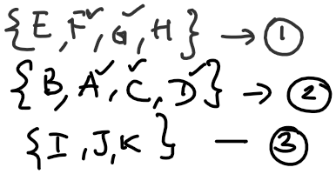
Graph Clustering using a similarity matrix
Clusters formed

Slide 86
Minimum Spanning Tree (MST) Clustering
Step1: Build MST (Minimum Spanning Tree)
For the given set of points construct the proximity matrix
Build the MST from the proximity matrix
Prim’s / Kruskal’s algorithm
Kruskal’s algo
Sort the edge list of the graph in ascending order
At each step, select the edges that has smallest weight and include it in the MST as long as it does not form a cycle

Slide 87
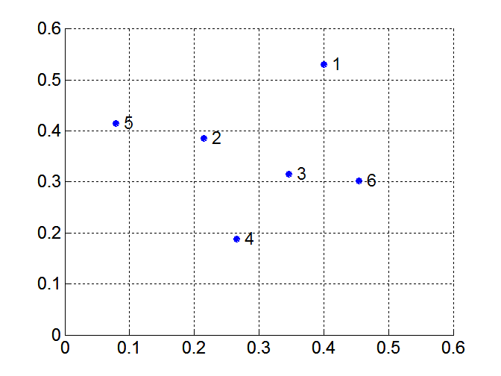
Build MST (Minimum Spanning Tree)
Distance Matrix:
Data points

Slide 88
Minimum Spanning Tree (MST) Clustering
Build MST (Minimum Spanning Tree)
Distance Matrix:

Slide 89
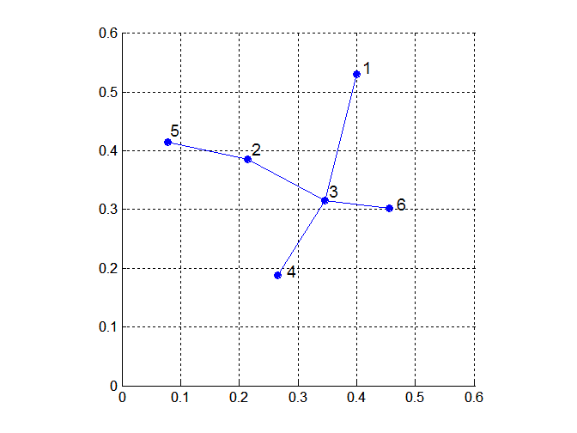
Minimum Spanning Tree (MST) Clustering

Slide 90
Minimum Spanning Tree (MST) Clustering
Step2: Use MST for constructing clusters
Repeat
Create a new cluster by breaking the link corresponding to the largest dissimilarity
Until no more clusters can be formed/ a specified number of clusters are obtained
2 clusters ➔ remove I edge
3 clusters ➔ remove 2 edges and so on
k clusters ➔ remove k-1 edges

Slide 92
Minimum Spanning Tree (MST) Clustering
Example: Consider the data points A(1,1), B(1,2), C(3,2), D(3,3), E(6,6), F(6,7), G(7,6), H(7,7). Illustrate the working of minimum spanning tree clustering to cluster the given points. Use Euclidean distance metric to form the proximity matrix.
 | A | B | C | D | E | F | G | H
A | 0 | 1 | 2.23 | 2.82 | 7.07 | 7.81 | 7.81 | 8.48
B | 1 | 0 | 2 | 2.3 | 6.4 | 7.07 | 7.07 | 7.81
C | 2.23 | 2 | 0 | 1 | 5 | 5.83 | 5.65 | 6.4
D | 2.82 | 2.3 | 1 | 0 | 4.24 | 5 | 5 | 5.6
E | 7.07 | 6.4 | 5 | 4.24 | 0 | 1 | 1 | 1.41
F | 7.81 | 7.07 | 5.83 | 5 | 1 | 0 | 1.41 | 1
G | 7.81 | 7.07 | 5.65 | 5 | 1 | 1.41 | 0 | 1
H | 8.48 | 7.81 | 6.4 | 5.6 | 1.41 | 1 | 1 | 0

Slide 93
Example
Ordered edge list
AB -1 BD - 2.3 CH - 6.4
CD - 1 AD - 2.82 AE- 7.07
EF - 1 DE -4.24 BF
EG -1 BG
FH -1 CE - 5 AF- 7.81
GH -1 DF 5 AG
EH- 1.41 DG - 5 BH
FG -1.41 CG - 5.65 AH - 8.48
BC- 2 DH - 5.65
AC -2.23 CF - 5.83
BE - 6.4

Slide 94
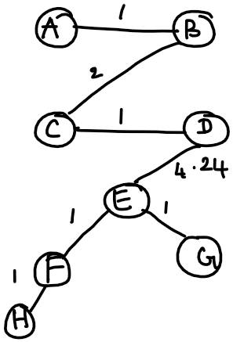
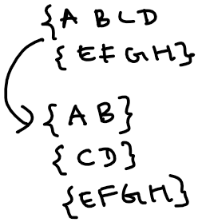
Example
Clusters
MST

Slide 95
SNN Similarity Computation
Shared nearest neighbor (SNN) similarity
Idea is to take the context of points into account in defining the similarity measure
SNN similarity of two objects can be computed if
the two objects are on each other’s nearest neighbor lists
SNN similarity of two objects is
the number of shared neighbors of the two objects

Slide 96
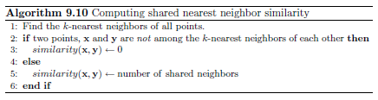
SNN Similarity Computation
Note that the underlying proximity measure can be any meaningful similarity or dissimilarity measure
i
j
i
j
4

Slide 97
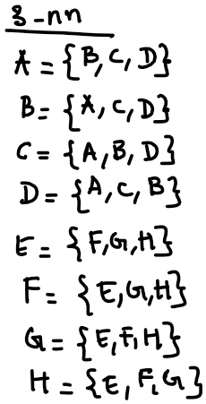
SNN Similarity Computation
Example: Compute the SNN similarity using the distance matrix of the given graph assuming k = 3 neighbors
 | A | B | C | D | E | F | G | H
A | 0 | 1 | 2.23 | 2.82 | 7.07 | 7.81 | 7.81 | 8.48
B | 1 | 0 | 2 | 2.3 | 6.4 | 7.07 | 7.07 | 7.81
C | 2.23 | 2 | 0 | 1 | 5 | 5.83 | 5.65 | 6.4
D | 2.82 | 2.3 | 1 | 0 | 4.24 | 5 | 5 | 5.6
E | 7.07 | 6.4 | 5 | 4.24 | 0 | 1 | 1 | 1.41
F | 7.81 | 7.07 | 5.83 | 5 | 1 | 0 | 1.41 | 1
G | 7.81 | 7.07 | 5.65 | 5 | 1 | 1.41 | 0 | 1
H | 8.48 | 7.81 | 6.4 | 5.6 | 1.41 | 1 | 1 | 0

Slide 98
SNN Similarity Computation
SNN-similarity matrix
 | A | B | C | D | E | F | G | H
A | 0 | 2 | 2 | 2 | 0 | 0 | 0 | 0
B | 2 | 0 | 2 | 2 | 0 | 0 | 0 | 0
C | 2 | 2 | 0 | 2 | 0 | 0 | 0 | 0
D | 2 | 2 | 2 | 0 | 0 | 0 | 0 | 0
E | 0 | 0 | 0 | 0 | 0 | 2 | 2 | 2
F | 0 | 0 | 0 | 0 | 2 | 0 | 2 | 2
G | 0 | 0 | 0 | 0 | 2 | 2 | 0 | 2
H | 0 | 0 | 0 | 0 | 2 | 2 | 2 | 0

Slide 99
Graph-Based Clustering: SNN Approach
Shared Nearest Neighbor (SNN) graph
Constructed using the SNN matrix as a adjacency matrix
The nodes are the data points/samples
Edge signifies the connection between the samples
The weight of an edge is the number of shared neighbors between nodes

Slide 100
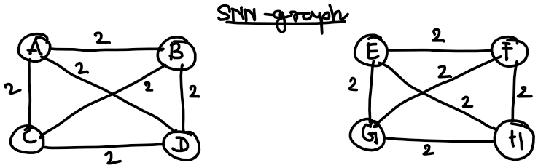
SNN-similarity matrix

Slide 101
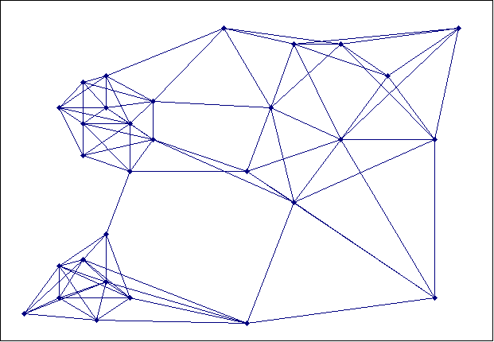
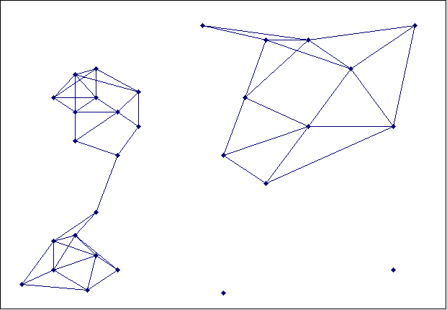
Creating the SNN Graph
Proximity Graph
Link weights are similarities/dissimilarities between neighboring points
Shared Nearest Neighbor Graph
Link weights are number of Shared Nearest Neighbors

Slide 102
Jarvis-Patrick Clustering
Compute the proximity matrix
Find, the k-nearest neighbors of all points
Compute SNN similarity for all points using the neighbors
Construct the SNN graph
Cluster the points
A pair of points is put in the same cluster if the two points
are in each others k nearest neighbor list
share more than or equal to T neighbors

Slide 103
Example
0
2
Consider the input graph
Assume:
Neighbors of a node: All nodes with which there is an edge
Weight of edges is 1
Illustrate Jarvis Patrick clustering using a threshold value of T=3
4
1
3

Slide 104
Example

Slide 105
Example
Input graph
Shared Nearest Neighbor Graph
0
2
2
0
2
1
4
2
2
3
4
2
1
3
1
1
3
2
Node 0 and Node 1 have 2 neighbors in common
Node 2 and Node 3 have 3 neighbors in common

Slide 106
Example
2
0
2
1
If u and v share more than or equal to T neighbors
Place them in the same cluster
2
2
2
3
4
1
1
3
2
E.g., τ =3
0
2
4
1
3

Slide 107
Density-based Clustering
Based on the notion of density
Idea is to continue growing a given cluster as long as the density (number of objects or data points) in the “neighborhood” exceeds some threshold
Discover clusters of arbitrary shape

Slide 108
DBSCAN - Density Based Spatial Clustering of Applications with Noise
DBSCAN is a density-based clustering algorithm
Find clusters of arbitrary shape
Strategy: Model clusters as dense regions in the data space, separated by sparse regions
The density of an object/data point
can be measured by the number of objects within a specified radius (Eps) of that point i.e., close to the point
Density depends on the radius specified

Slide 109
DBSCAN - Density Based Spatial Clustering of Applications with Noise
Classification of points
A point is a core point if it has at least a specified number of points (MinPts) within Eps
These points are at the interior of a cluster
Counts the point itself
A border point is not a core point, but is in the neighborhood of a core point at the edge of a dense region
A noise point is any point that is not a core point or a border point

Slide 110
DBSCAN: Core, Border, and Noise Points
MinPts = 7

Slide 111
DBSCAN Algorithm
Label all points as core, border, or noise points.
Noise points are discarded.
Any two core points that are close enough—within a distance Eps of one another—are put in the same cluster.
Any border point that is close enough to a core point is put in the same cluster as the core point. (Ties may need to be resolved if a border point is close to core points from different clusters.)

Slide 112
DBSCAN Algorithm
Point | X | y
P1 | 3 | 7
P2 | 4 | 6
P3 | 5 | 5
P4 | 6 | 4
P5 | 7 | 3
P6 | 6 | 2
P7 | 7 | 2
P8 | 8 | 4
P9 | 3 | 3
P10 | 2 | 6
P11 | 3 | 5
P12 | 2 | 4
Illustrate the working of the DBSCAN algorithm for the given 2-dimensional datapoints. Use Euclidean metric to find the proximity between the data points. Assume Eps =1.9 and Minpts = 4

Slide 113
DBSCAN Algorithm
P1 | 0
P2 | 1.41 | 0
P3 | 2.83 | 1.41 | 0
P4 | 4.24 | 2.83 | 1.41 | 0
P5 | 5.66 | 4.24 | 2.83 | 1.41 | 0
P6 | 5.83 | 4.47 | 3.16 | 2.00 | 1.41 | 0
P7 | 6.40 | 5.00 | 3.61 | 2.24 | 1.00 | 1.00 | 0
P8 | 5.83 | 4.47 | 3.16 | 2.00 | 1.41 | 2.83 | 2.24 | 0
P9 | 4.00 | 3.16 | 2.83 | 3.16 | 4.00 | 3.16 | 4.12 | 5.10 | 0
P10 | 1.41 | 2.00 | 3.16 | 4.47 | 5.83 | 5.66 | 6.40 | 6.32 | 3.16 | 0
P11 | 2.00 | 1.41 | 2.00 | 3.16 | 4.47 | 4.24 | 5.00 | 5.10 | 2.00 | 1.41 | 0
P12 | 3.16 | 2.83 | 3.16 | 4.00 | 5.10 | 4.47 | 5.39 | 6.00 | 1.41 | 2.00 | 1.41 | 0
 | P1 | P2 | P3 | P4 | P5 | P6 | P7 | P8 | P9 | P10 | P11 | P12

Slide 114
DBSCAN Algorithm
For each point, identify the data points that lie within its Eps radius.
P1:P2, P10 | 3 | P7: P5, P6 | 3
P2: P1, P3, P11 | 4 | P8: P5 | 2
P3: P2, P4 | 3 | P9: P12 | 2
P4: P3, P5 | 3 | P10: P1, P11 | 3
P5: P4, P6, P7, P8 | 5 | P11: P2, P10, P12 | 4
P6: P5, P7 | 3 | P12: P9, P11 | 3

Slide 115
DBSCAN Algorithm
Points | Status after 1st iteration | Final status
P1 | Noise | Border
P2 | Core
P3 | Noise | Border
P4 | Noise | Border
P5 | Core
P6 | Noise | Border
P7 | Noise | Border
P8 | Noise | Border
P9 | Noise
P10 | Noise | Border
P11 | Core
P12 | Noise | Border
Three clusters are formed:
P2, P1, P3, P11
P5, P4, P6, P7, P8
P11, P2, P10, P12
As two core points P2 and P11 are within the Eps neighbourhood of one another, they are put in the same cluster.
Clusters formed are:
P2, P1, P3, P11, P10, P12
P5, P4, P6, P7, P8

Slide 116
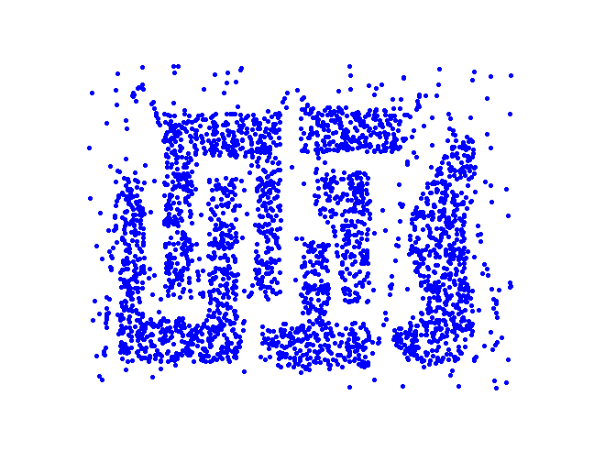
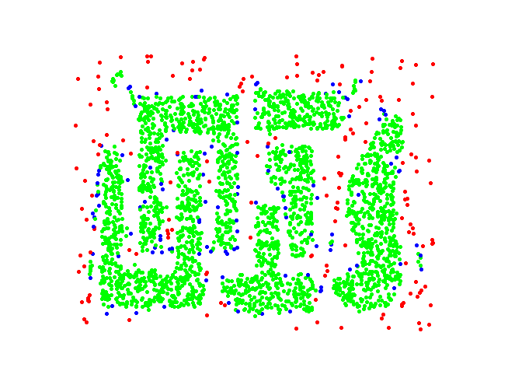
DBSCAN: Core, Border and Noise Points
Original Points
Point types: core, border and noise
Eps = 10, MinPts = 4

Slide 117
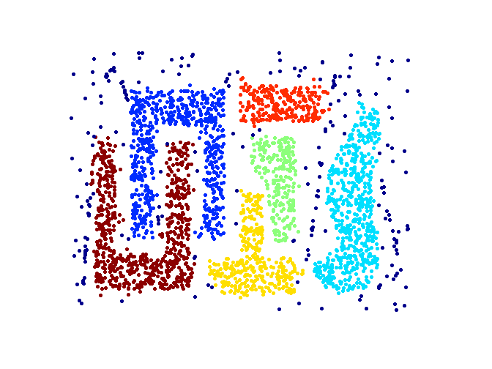
When DBSCAN Works Well
Original Points
Clusters
Resistant to Noise
Can handle clusters of different shapes and sizes

Slide 118
When DBSCAN Does NOT Work Well
Varying densities
High-dimensional data

Slide 119
Thank you

